Slide 1

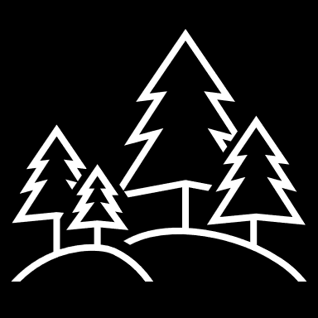
Random Forests Machine Learning Technique for Email Spam Filtering
אורי קסלמן 306131673
אלמוג רחמים 062876206

Slide 2
The spam problem
Spam emails contain fraudulent content aimed to lure people to release confidential information
Reports showed that spam mails are accountable for more than 77% of the email traffic globally
Majority of the email spam filtering methods use text categorization approaches and have poor performance and low efficiency

Slide 3
Email Spam Filtering Features
Volume of the message
Occurrence count of words
Number of semantic discrepancies patterns in the message
Recipient age, sex and country
Adult content
Bag of words from the message content
Domain name and IP Address
Blank lines in body
Length of sequences of consecutive capital letters

Slide 4
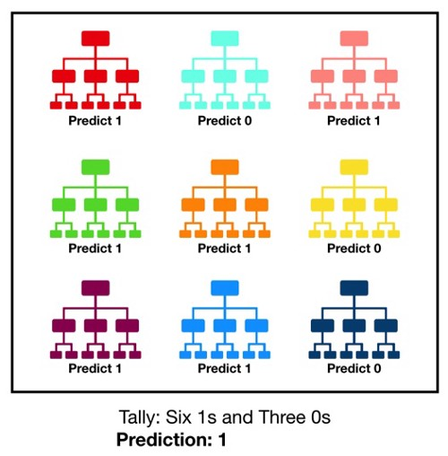
Random Forest Overview
Consists of many individual decision trees that operate as an ensemble
Each decision tree uses a random subset of features
Each individual tree in the random forest spits out a class prediction
The class with the most votes becomes our model’s prediction
While some trees may be wrong, many other trees will be right, so as a group the trees are able to move in the correct direction

Slide 5
Random Forest Technique for Email Spam Filtering
Reduced classification error
Better f-scores
Performance is generally as good as or even superior to that of SVMs
Can efficiently handle unbalanced data sets that have missing values
The training time for RFs is usually shorter compared to that of SVMs and Neural Networks
Is better than most of the existing machine learning algorithms in terms of accuracy

Slide 6
Experiment results
Class | PRC Area | ROC Area | F-measure | Recall | Precision | FP Rate | TP Rate
ham | 1.000 | 1.000 | 1.000 | 1.000 | 1.000 | 0.001 | 0.999
norm | 1.000 | 1.000 | 1.000 | 1.000 | 1.000 | 0.000 | 1.000
spam | 1.000 | 1.000 | 0.999 | 0.999 | 0.998 | 0.001 | 0.999
 | 1.000 | 1.000 | 0.999 | 0.999 | 0.999 | 1.000 | 0.999
Weighted Avg.

Slide 7
Random Forest Prerequisites
There needs to be some actual signal in our features so that models built using those features do better than random guessing (if we put garbage in then we will get garbage out)
The predictions (and therefore the errors) made by the individual trees need to have low correlations with each other

Slide 8
Ensuring model diversity
Bagging (Bootstrap Aggregation) - decisions trees are very sensitive to the data they are trained on - small changes to the training set can result in significantly different tree structures. Allowing each individual tree to randomly sample from the dataset with replacement, resulting in different trees.
Feature Randomness - each tree in a random forest can pick only from a random subset of features. This forces even more variation amongst the trees in the model and ultimately results in lower correlation across trees and more diversification.
Conclusion: in random forest, we end up with trees that are not only trained on different sets of data (thanks to bagging) but also use different features to make decisions.

Slide 9
Random Forest Metrics
Precision = TP/(TP+FP)
Recall = TP/(TP+FN)
Accuracy = TP+TN/(TP+TN+FP+FN)
F Score = 2*Precision*Recall/(Precision + Recall)
Positive Precision = TP/(TP+FP)
Negative Precision = TN/(TN+FN)
Positive Recall = TP/(TP+FN)
Negative Recall = TN/(TN+FP)
Area Under Precision Recall Curve
Area Under Roc Curve

Slide 10
Our example – Spam Filter application
56,611 emails messages, 17,172 spam, 39,439 non-spam
Use email’s subject and body
Use the “FeaturizeText” (Microsoft.ML) transformation that performs the following:
Normalize the text (remove punctuation, diacritics, switching to lowercase etc.)
Tokenize each word
Remove all stop-words
Extract N-grams and skip-grams
TF-IDF rescaling
Bag of words conversion
Train on 80% of the data, then test on the remaining 20%

Slide 11
Our results
 | Forest: (2-5) | Forest: (5-10) | Forest: (10-20)
Accuracy: | 0.9993 | 0.9994 | 0.9994
F1 Score: | 0.1212 | 0.2897 | 0.3014
Positive Precision: | 0.8889 | 0.9545 | 0.9565
Negative Precision: | 0.9993 | 0.9994 | 0.9994
Positive Recall: | 0.0650 | 0.1707 | 0.1789
Negative Recall: | 1.0000 | 1.0000 | 1.0000
Area Under Precision Recall Curve: | 0.0788 | 0.2830 | 0.2354
Area Under Roc Curve: | 0.5325 | 0.6463 | 0.6866

Slide 12
Thank you !

